Slide 1
Chapter 11 – Neural Nets
Data Mining for Business Analytics
Concepts, Techniques and Applications with JMP Pro
Shmueli, Bruce, Stephens & Patel
© Galit Shmueli, Peter Bruce and Mia Stephens 2016

Slide 2
Basic Idea
Combine input information in a complex and flexible neural net “model”
Model “coefficients” are continually tweaked in an iterative process
The network’s interim performance in classification and prediction informs successive tweaks

Slide 3
Network Structure
Multiple layers
  Input layer (raw observations)
  Hidden layers
  Output layer
Nodes
Weights (like coefficients, subject to iterative adjustment)
Bias values (also like coefficients, but not subject to iterative adjustment)

Slide 4
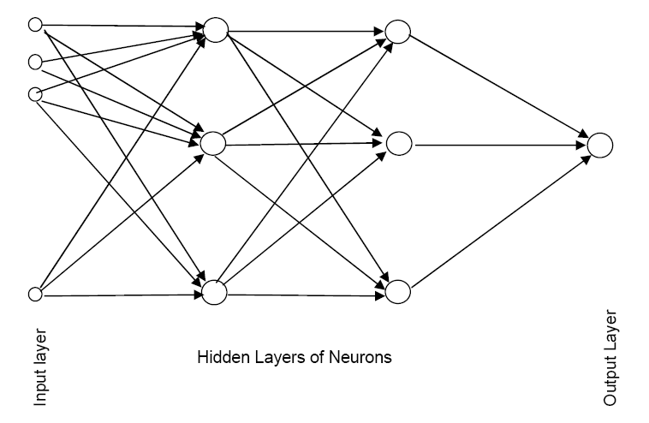
Schematic Diagram

Slide 5
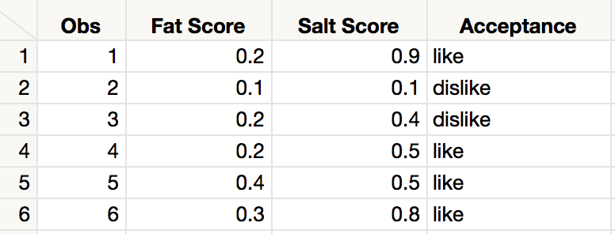
Tiny Example
Using fat and salt content to predict consumer acceptance of cheese

Slide 6
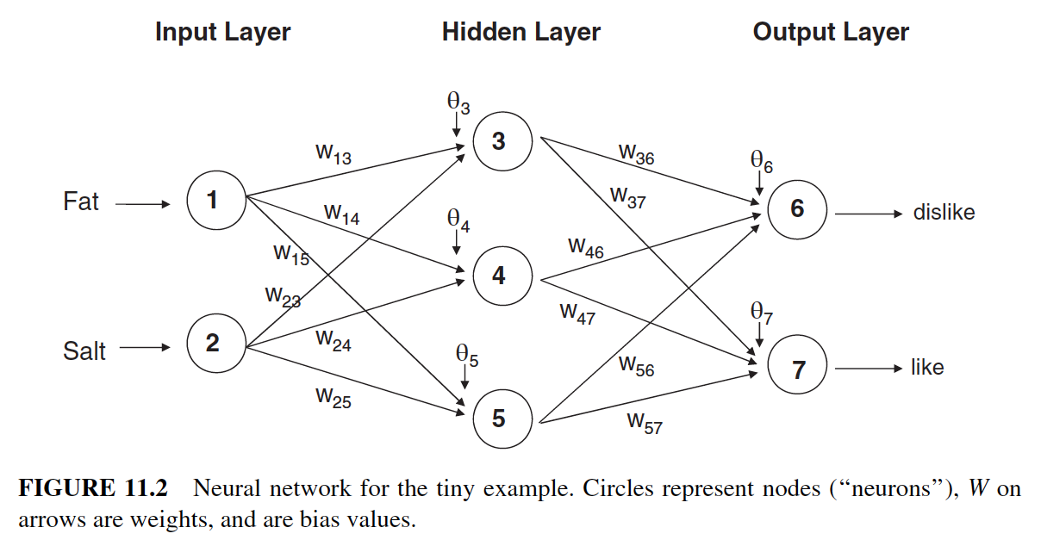
Tiny Example Neural Network
Notes:
Note that neural models in JMP only display one node in the output layer.

Slide 7
Moving Through the Network

Slide 8
The Input Layer
For input layer, input = output
E.g., for record #1:
  Fat input = output = 0.2
  Salt input = output = 0.9
Output of input layer = input into hidden layer

Slide 9

The Hidden Layer
In this example, hidden layer has 3 nodes
Each node receives as input the output of all input nodes
Output of each hidden node is a function of the weighted sum of inputs
(The hidden layer function is also called an ”activation function”.)

Slide 10
The Weights
The weights θ (theta) and w are typically initialized to random values in the range -0.05 to +0.05
  JMP uses random normal starting weights
Equivalent to a model with random prediction (in other words, no predictive value)
These initial weights are used in the first round of training

Slide 11
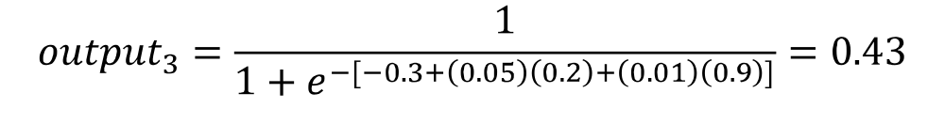
Output of Node 3, if g is a Logistic Function

Slide 12
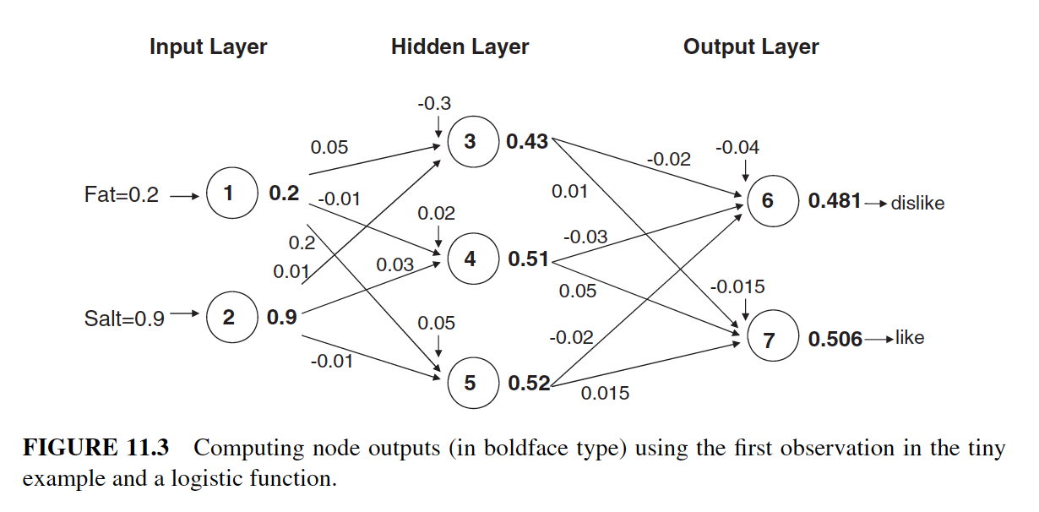
Tiny Example Neural Weights

Slide 13
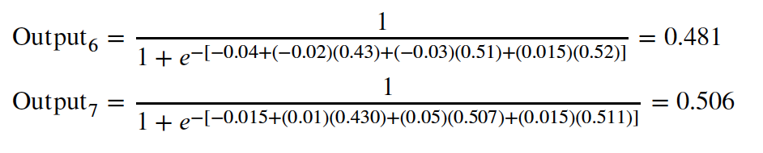
Output Layer
The output of the last hidden layer becomes input for the output layer
Uses same function as above, i.e. a function g of the weighted average

Slide 14
Tiny Example Output Layer

Slide 15
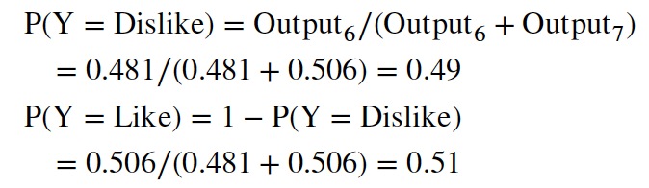
Mapping the output to a classification
These values are normalized so they are propensities (which add up to 1.0).
The default cutoff for classification is 0.5.
This first record would be classified as a Like.
Notes:
Note that JMP calculates propensities (probabilities) directly from the hidden layer (without normalizing)

Slide 16

Relation to Linear Regression
A net with a single output node and no hidden layers, where g is the identity function, takes the same form as a linear regression model

Slide 17
Training the Model

Slide 18
Initial Pass Through Network
Goal: Find weights that yield best predictions
The process we described above is repeated for all records
At each record, compare prediction to actual
Difference is the error for the output node
Error is propagated back and distributed to all the hidden nodes and used to update their weights

Slide 19
Back Propagation of Error
Output from output node k:
Error associated with that node:
Note: this is like ordinary error, multiplied by a correction factor

Slide 20

Error is Used to Update Weights
l = constant between 0 and 1, reflects the “learning rate” or “weight decay parameter”

Slide 21
Case Updating
Weights are updated after each record is run through the network
Completion of all records through the network is one epoch (also called sweep or iteration)
After one epoch is completed, return to first record and repeat the process

Slide 22
Batch Updating
All records in the training set are fed to the network before updating takes place
In this case, the error used for updating is the sum of all errors from all records

Slide 23
Why It Works
Big errors lead to big changes in weights
Small errors leave weights relatively unchanged
Over thousands of updates, a given weight keeps changing until the error associated with that weight is negligible, at which point weights change little

Slide 24
Common Criteria to Stop the Updating
When weights change very little from one iteration to the next
When the misclassification rate reaches a required threshold
When a limit on runs is reached

Slide 25
Neural Model fitting in JMP Pro
JMP uses an algorithm that finds optimal values of weights and bias values that minimize a function of the combined errors (maximum likelihood)
This approach produces similar results to back propagation, but
  Its generally much faster
  It can be used for both continuous and categorical responses

Slide 26
Neural Model fitting in JMP Pro
Neural models tend to overfit the data.
To avoid overfitting, JMP uses a penalty parameter and requires crossvalidation
The JMP Neural fitting process:
  Set the penalty to 0
  Use random normal weights for the starting values
  Vary the penalty parameter
  For each value of the penalty parameter, search for weights that minimize error
  Select the model with the lowest crossvalidation error

Slide 27
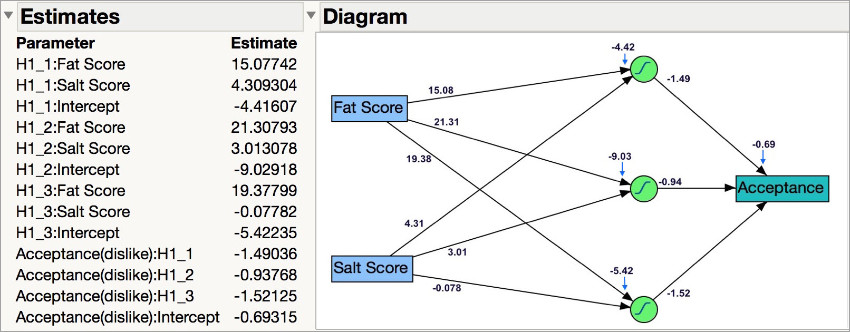
Tiny Example: Final Weights
Notes:
Note that the weights aren’t displayed on the diagram – they were added manually for illustration. The weights are provided in the Estimates table

Slide 28
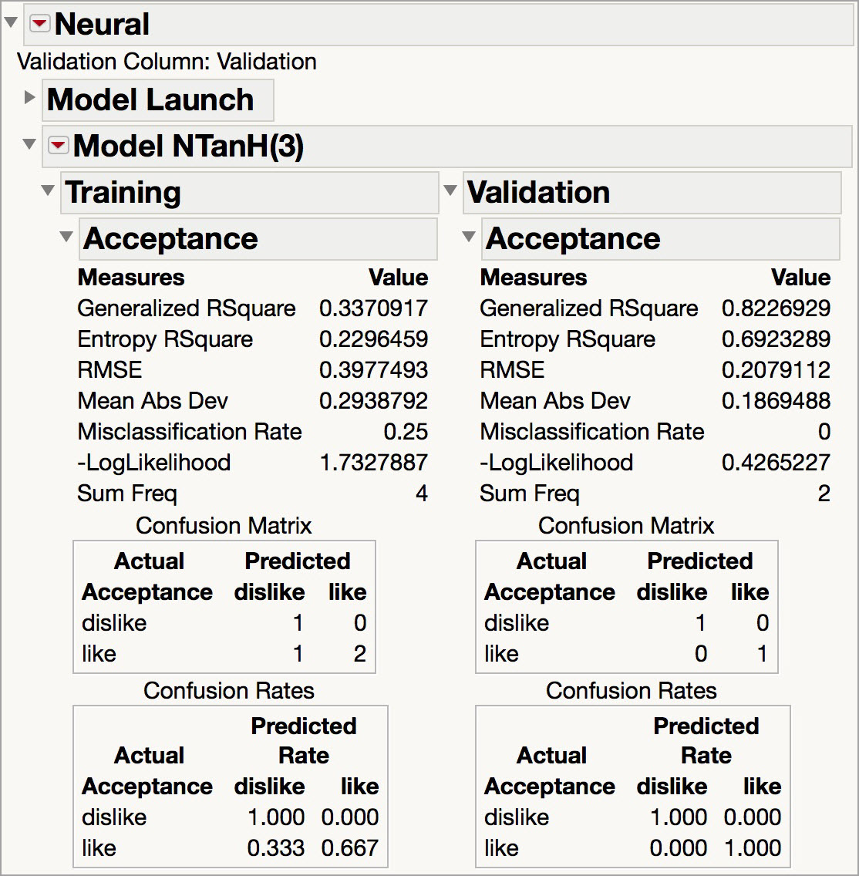
Tiny Example: Fit Statistics

Slide 29
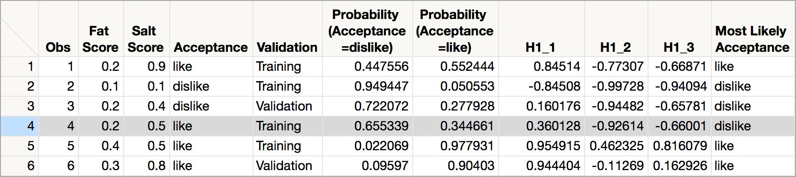
Tiny Example: Classifications
Estimated propensities and classifications
One record in the training set was misclassified
Both records in the validation set were correctly classified
Notes:
Save the formula to the data table. Note: Because random starts are used, results will vary. To attain the same results each time you run the neural model first set the random seed. Use this add-in in JMP 12 (https://community.jmp.com/docs/DOC-6601). The option has been added in JMP 13.

Slide 30
User Inputs

Slide 31
Specify Network Architecture in JMP
Number of hidden layers
  Most popular – one hidden layer
Number of nodes in hidden layer(s)
  More nodes capture complexity, but increase chances of overfit
Hidden Layer Activation Functions
  Combinations of three functions (TanH, Linear and Gaussian) can be applied in the hidden layers to add model complexity

Slide 32
JMP Network Architecture, cont.
Number of tours
  How many times JMP restarts the model-fitting algorithm
“Learning Rate”
  Low values “downweight” the new information from errors at each iteration
  This slows learning, but reduces tendency to overfit to local structure

Slide 33
Advantages
Good predictive ability
Can capture complex relationships
No need to specify a model

Slide 34
Disadvantages
Considered a “black box” prediction machine, with no insight into relationships between predictors and outcome
No variable-selection mechanism, so you have to exercise care in selecting variables
Heavy computational requirements if there are many variables

Slide 35
Addressing Disadvantages in JMP Pro
Considered a “black box” prediction machine, with no insight into relationships between predictors and outcome
  JMP Prediction Profiler allows you to explore the model
No variable-selection mechanism, so you have to exercise care in selecting variables
  JMP Variable Importance can help identify most important variables
Heavy computational requirements if there are many variables
  The JMP Neural algorithm is more efficient than back propagation

Slide 36
Summary
Neural networks can be used for classification and prediction
Can capture a very flexible/complicated relationship between the outcome and a set of predictors
The network “learns” and updates its model iteratively as more data are fed into it
Major danger: overfitting
Requires large amounts of data
Good predictive performance, yet “black box” in nature

